Slide 1
Notes:
Alexis

Slide 2
2024 - 2025 Program Informational
November 2024
Program Team Introductions
Mentorship Program Overview
Application Information
Questions and Next Steps
Notes:
Alexis

Slide 3
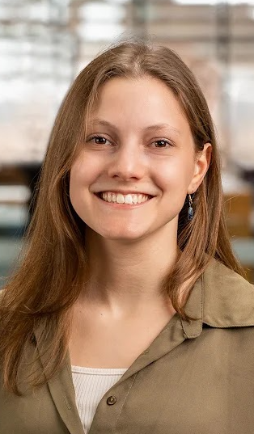
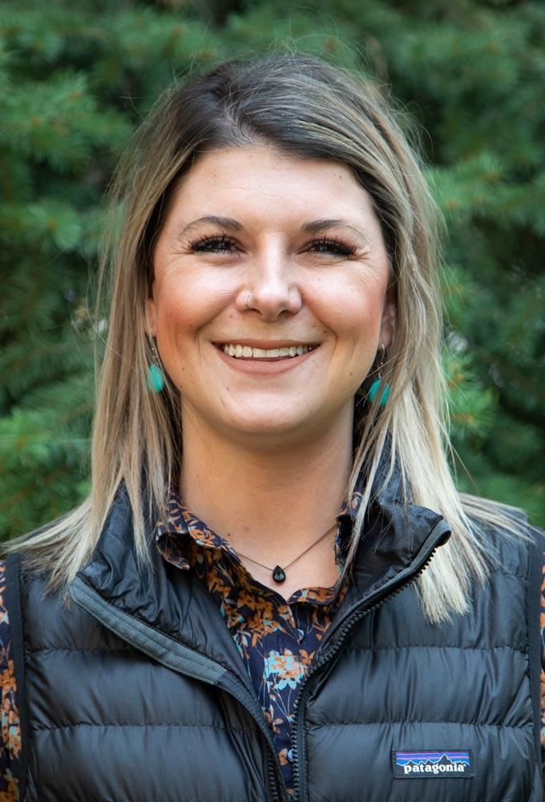
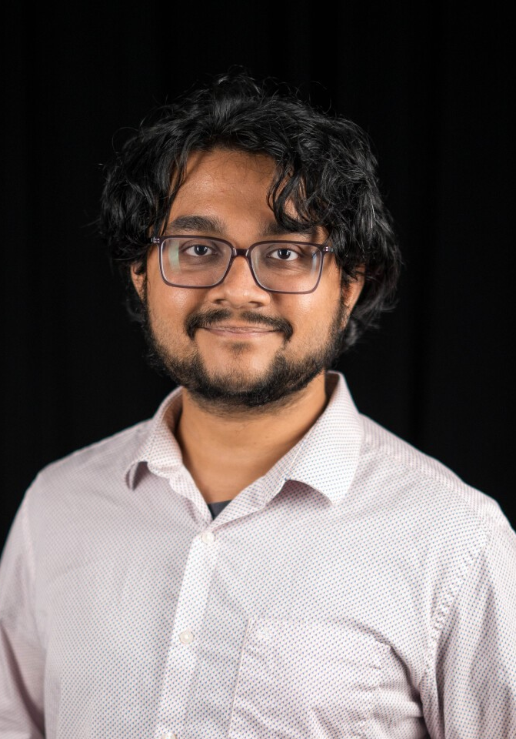
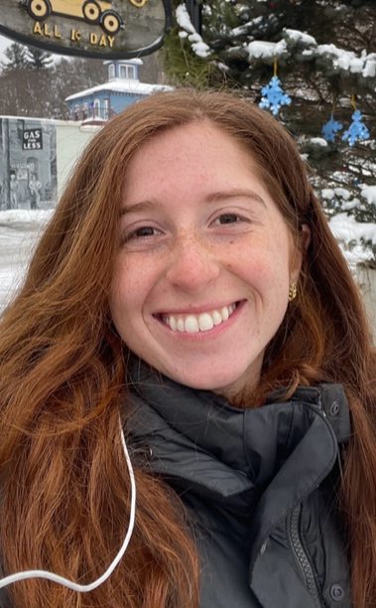
Program Team
Angelina DeBenedet
Program Coordinator
ASAP
Tamera Breidenbach
Junior Environmental Scientist
Colorado State University
Varun Bhat
PhD Candidate
Worcester Polytechnic Institute
Alexis Monti
Climate Resiliency Specialist
Wild Rivers Conservancy
Notes:
Alexis

Slide 4
2025
Mentorship
Program
Overview
Notes:
Alexis

Slide 5
Mentorship Program Overview
Nine month framework to:
Expand participant social networks
Assist mentees in developing adaptation skills
Connect emerging professionals with experienced members
Create a space to solve challenges together
Foster a safe community to grow with
With support and guidance from the ASAP Mentorship Program Team
Notes:
Alexis

Slide 6
Roles and Responsibilities - Mentee Led
Roles
Mentees
Lead the mentoring relationship
Drive interactions by defining personal goals and setting discussion topics
Schedule and set up one-on-one calls
Complete “Mentorship Profile”
Mentors
Support mentee’s pursuit of their goals and interests
Share knowledge, resources, advice and contacts
Notes:
Alexis

Slide 7
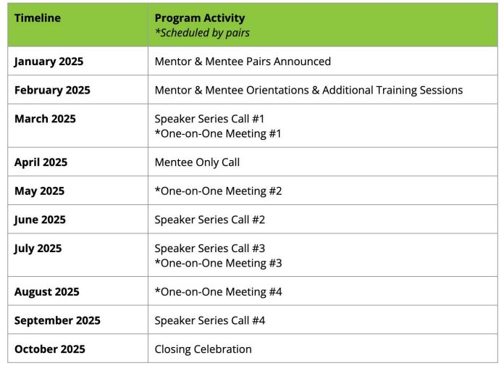
Program Timeline
Notes:
Alexis

Slide 8
Mentor-Mentee Pairing - UPDATED PROGRAM ELEMENT
Updated pairing process
No kick-off social
Based on interest/career level rather than specific individualized selection
Broadens ability to connect with others based on strategic pairing process
Questions to application will allow Program team to pair based on interest and other elements
Notes:
Varun

Slide 9
One-on-One Calls - REQUIRED
Four (4) One-on-One Calls
March, May, July, August
Scheduled calls between mentee-mentor
Allows mentor groups to connect and get to know each other
Call content will vary based on mentee’s needs, e.g.,
Collaborate or provide feedback on a project
Review the structure of resume or provide interview tips
Brainstorm solutions to a challenge mentees are currently facing
Notes:
Varun

Slide 10
Mentee Only Call - REQUIRED
One call in April
Mentees exchange questions with each other and program team
Connect mentees to learn with peers
Ensure mentees have what they need to be successful in the Program
Notes:
Varun

Slide 11
Speaker Series Calls- NEW PROGRAM ELEMENT
Three Panel Discussions
March, June, July, Sept
In place of cross-cohort calls
Invited speakers from ASAP’s network build stronger connections across members
Features professional development topics decided on by program participants
Opportunity for networking
*Have a topic you’d
like to discuss? Let us know! *
Notes:
Varun

Slide 12
Celebration Call - NEW PROGRAM ELEMENT
Final Mentorship Program Call
October
Final call to celebrate the completion of the program
Submit final survey/feedback
Awarding of program certificates
Notes:
Varun

Slide 13
Application Information
Notes:
Angelina

Slide 14
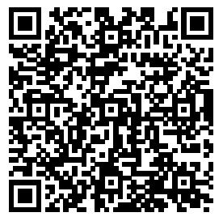
DEADLINE FOR APPLYING - DECEMBER 13, 2024 (11:59 ET)
What information do mentors need to give?
Personal information (contact info, name, preferred pronouns, location, timezone)
Previous experience as a mentor (past years of experience, working sector or region)
What are you hoping to get out of the program?
What is your maximum capacity of mentees?
Speaker Series topics of interest
Resume
Mentors
Notes:
Angelina

Slide 15
DEADLINE FOR APPLYING - DECEMBER 13, 2024 (11:59 ET)
What information do mentees need to give?
Personal information (contact info, name, preferred pronouns, location, timezone)
Where are you in your adaptation journey? (aspiring graduate, junior level, shifting careers)
What are you hoping to get out of the program?
What do you look for in a mentor?
What adaptation topics interest you?
Resume
Mentees
Notes:
Angelina

Slide 16
Orientation & Trainings
Group orientations for mentors and mentees
Mentoring relationships
Coordination tips
Training on cultural humility
Notes:
Angelina

Slide 17
Get involved with ASAP!
Join a monthly peer-learning group call! See calendar here.
Follow our Network News and Jobs/Ops newsletters to learn more about professional development, training, and publication updates.
Connect with us on Slack and join the #mentorship2024-2025 channel!
https://adaptationprofessionals.org/join-us/
info@adaptpros.org
https://adaptationprofessionals.org/
Notes:
Angelina

Slide 18
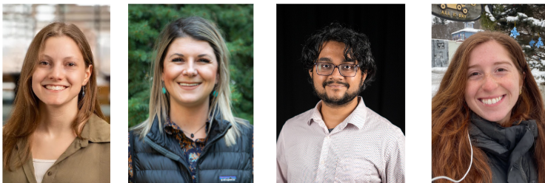
Questions or feedback?
Contact:
Angelina DeBenedet - adebenedet@adaptpros.org
Tamera Breidenbach - tbreiden@colostate.edu
Varun Bhat - vpbhat@wpi.edu
Alexis Monti - amonti9114@gmail.com
Thank you for your interest in the 2025 ASAP Mentorship program!
Notes:
Angelina

